Slide 1
Sixth Form
SIXTH FORM
Virtual Induction
July 2020

Slide 2
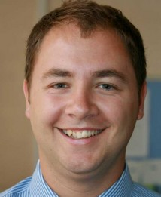
Welcome
Head of 6th Form- Mr Hanson
Here to support you with:
Your studies.
Pastoral care.
Well being and safety.
To help you achieve everything you aspire to.
Plan trips to support and inspire your future.

Slide 3
Why Should I Join?
Established at Dame Elizabeth
Sixth Form is not just a bolt on to Dame Elizabeth Cadbury.
It is an integral part of the whole school.
We offer a number of different subjects.
It’s successful!
Many students have gone on to university
Those who attend University earn, on average, £6000 more than those who don’t per annum.
Figures show people who attended university are more likely to be employed in later life.
All other students have secured apprenticeships/employment.
Familiar surroundings for our current Year 11 students
You know the school, the rules, the ethos

Slide 4
Why Should I Join?
Our current Y11 students already know the teachers already but if you are not currently in our Y11.
Really experienced staff and close links with examiners.
Good pastoral care, that will continue from your previous 5 years with us.
Outstanding teachers and support with studies to allow you to be as successful as possible, whether you want to go onto University, Apprenticeships or Employment.
5 hours of taught lessons for each subjects.

Slide 5
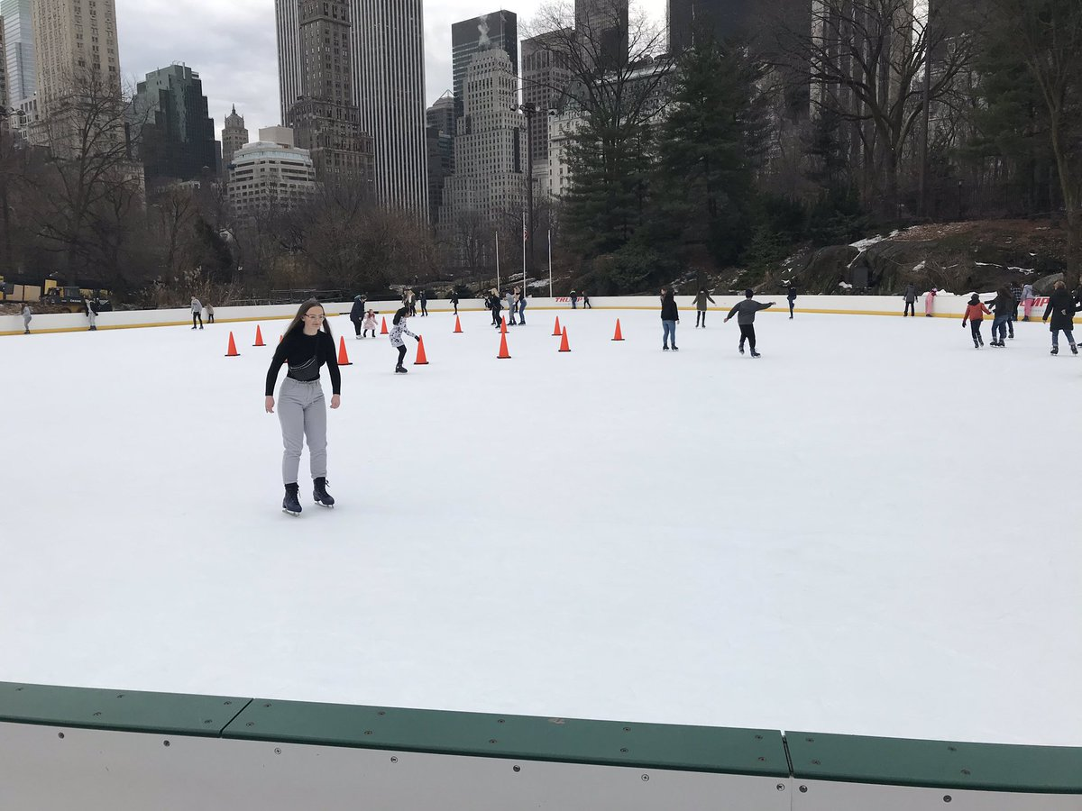
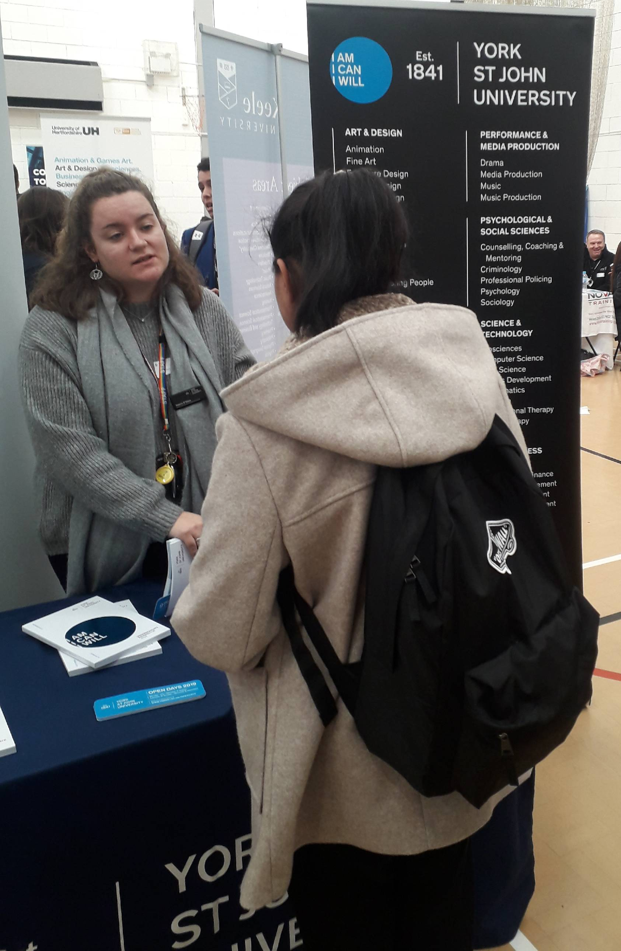
Why Should I Join?
University trips
Have a taste of what it’s like to go to University
Careers Fair
University or apprenticeship – we can help find out what’s right for you
Enrichment/Extended Offer
Enhance your life skills
Be a more confident individual
Subject Trips and External Speakers

Slide 6
Successful DEC 6th Formers
University College London - Mathematics
University of Manchester – Mathematics
Aston University – Engineering
Birmingham City University – Business & Finance
University of Birmingham – Physiotherapy
University of Worcester – Sport Science
University of Southampton – Sports Coaching
University of Central Lancaster – Policing and Criminal Studies
University of Derby – Law
University College Birmingham – Foundation Degree in Business
University of Central Lancaster – Policing and Criminal Studies
University of Worcester – BA Game & Art Design
Staffordshire University – Aerospace Technology

Slide 7
Successful DEC 6th Formers
Past DEC 6th Formers now on Apprenticeships or Training:
Apprenticeship in ICT and Web Design
Estate Agents Apprenticeship at Rice Chamberlin
Ignite Sports Apprenticeship
Apprenticeship programme with Gordon Franks Training
Life Guard and Leisure Management Training
Advanced Apprenticeship Business Management
Trainee Accountant – Broker
Intermediate Apprenticeship Engineering Operations
Personal Training Apprenticeship
Horticultural Apprenticeship

Slide 8
Attendance & Punctuality
Students need to maintain a high rate of attendance and punctuality to be successful in their studies and to prepare for Higher Education or future Careers
A minimum of 97% attendance rate is expected from all our students
The whole school attendance policy and procedures apply in 6th Form
Any student not meeting the expectation of 97% attendance will be supported to improve their attendance. Students may be issued with a contract of conditions they will need to meet to retain their place in 6th Form.
If for any reason a student arrives late to school e.g. due to a medical appointment, students sign in at reception
An appointment card should be shared with the Head of 6th Form 24 hours before an appointment (where possible)

Slide 9
Book Deposits/Purchases
For certain subjects, books and other resources will be vital to help support students in their studies
It is cheaper for students and parents if the school buys the resources and students borrow or buy these resources from us
In your pack you will be able to see the deposits required for certain subjects
If you are eligible for Pupil Premium/Bursary then funding will be available to help support the purchase/deposit of these books and contact should be made with Mr Hanson.

Slide 10
Bus Passes
For students who are eligible for Pupil Premium/Bursary funding, we can support with the costs of bus passes for students to get to and from school.
Please fill the PP request form in, if this applies to you.
Document titled:
Request for purchase/reimbursement from individual 6th Form Pupil Premium Fund

Slide 11
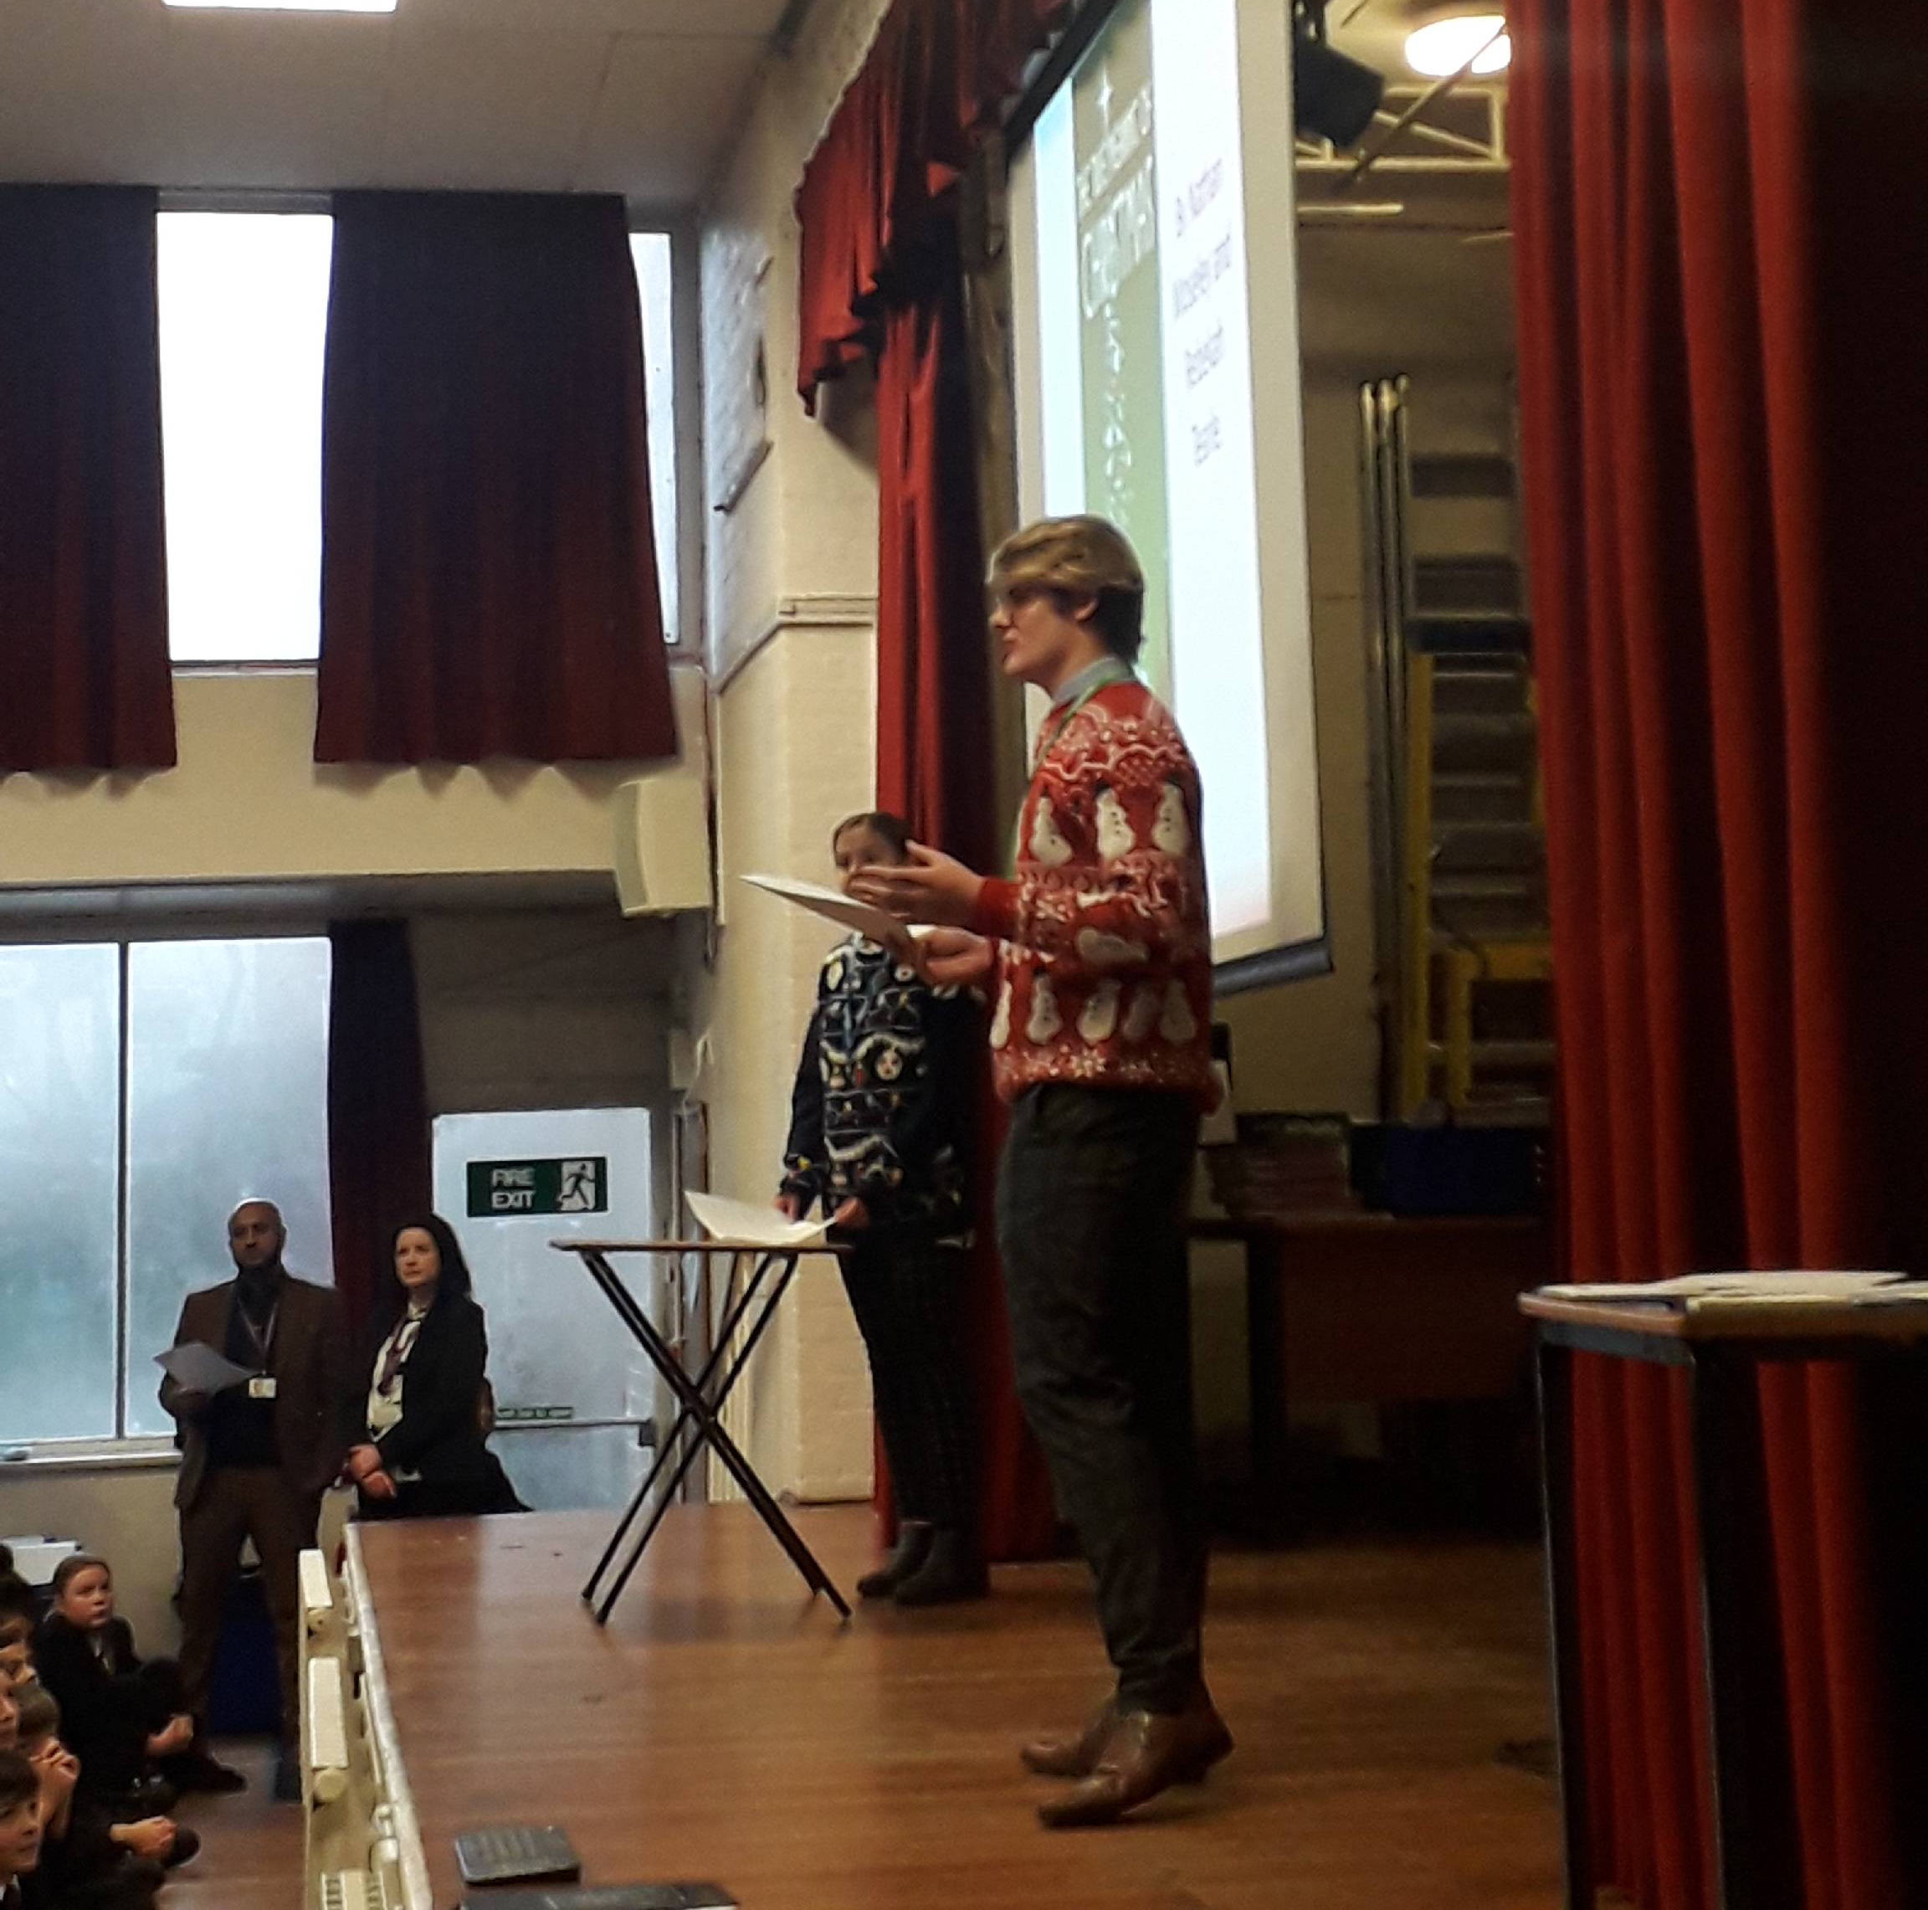
Form Time
Form time POS (SMSC, PSHE, British Values, e-safety, voting, health, mock interviews, well-being, taxes, current affairs etc)
Diaries (to be provided by us) to be used to record homework, messages home, to record attendance, punctuality, Working at Grades, target grades.
Y13 UCAS applications, our deadline for these are the end of first half term
Personal statements
6th Form assemblies

Slide 12
Work experience
Y12 students will take part in a week long work experience
8th – 12th February 2021.
Work experience is compulsory as it will inspire and help students for further education or job choices.
Looks great on CV/UCAS applications.
Students gain valuable experience in life and work based skills.
Helps students to build confidence in an area of employment they would like to move into.

Slide 13
Key Dates
Event | Date
GCSE Results Day & Enrolment | Thu 20 August 2020
Y12 Target setting Day & Induction | Wed 2 September 2020
Start of lessons | Thu 3 September 2020
DEC Y13 UCAS application deadlines (Medical & Oxbridge) | Fri 25 September 2020
DEC Y13 UCAS application deadlines (All other courses) | Mon 9 November 2020
6th Form Parents Evening | Thu 11 March 2021
Y12 Work Experience | W/b 8 February 2021

Slide 14
School Day
Example timings of the school day. Students will be in school everyday from Monday to Friday.
Time |  |  | Example timetable
8.40am | AM Form |  | AM Form
9.05am | Lesson 1 |  | Maths A Level lesson
10.05am | Lesson 2 |  | Maths A Level lesson
11.05am | Break |  | Break
11.25am | Lesson 3 |  | Study Period
12.25pm | Lesson 4 |  | Physics A Level lesson
1.25pm | Lunch |  | Lunch
1.55pm | Lesson 5 |  | Chemistry A Level lesson
2.55pm | PM Form |  | PM Form
3.05pm | End of school day |  | End of school day

Slide 15
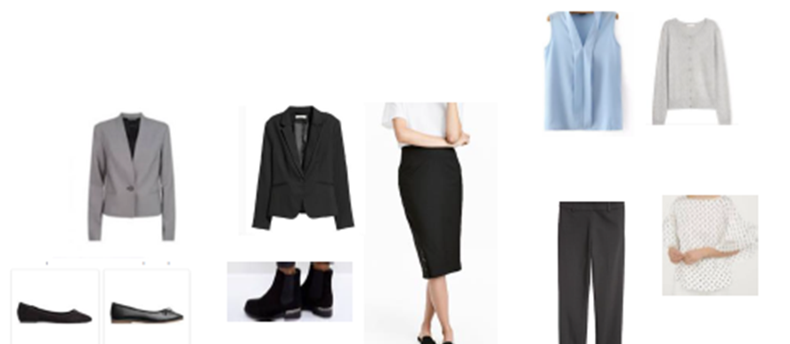
Dress code Smart office wear

Slide 16
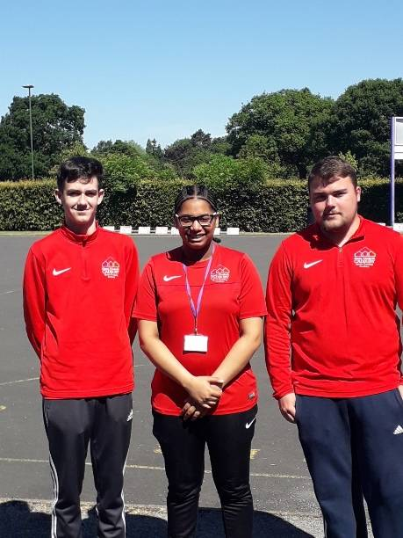
Sport/Coaching Uniform

Slide 17
Enrolment
Enrolment will take place on results day (Thursday 20 August).
Our current Y11 students will be informed of how enrolment will take place for you in a letter sent to all Y11 students.
If you are not a current Y11 student then you can enrol with us at school on results day or email Mr Hanson if you cannot attend school on this day
We will be here to help and support students in making the right choices for their future.

Slide 18
Questions?
If you do have any questions about anything to do with 6th Form then please email me: o.hanson@decschool.co.uk

